Slide 1
Security in E-government
Unit 5

Slide 2
Security in E-governance/E-government
Security is one of the most important issues in E-governance.
All of the security approaches that are common in E-commerce are applicable to E-governance.
But E-governance is a little different from E-commerce.
Usually government networks can communicate to each other better than business networks, because, most of them are connected for transferring information, but businesses are competitors and they don't disclose their sensitive information, so the security of E-government is much more important as compared to E-commerce.
Today the users or programmers (Hackers or abusers!) are very smart and intelligent, and they can attack in several forms and so the deffence level has to be sufficiently strong and comprehensive.

Slide 3
Security in E-governance/E-government
Implementation of E-governance has changed the way of living of the people in various countries.
At present scenario our most activities or needs are totally depend upon the E-governance, that’s why security of E-governance is a major issue.
we try to explain an approach for E-governance security which is based on specially two terms i.e.
“Security of What?”
“Security against What?”

Slide 4
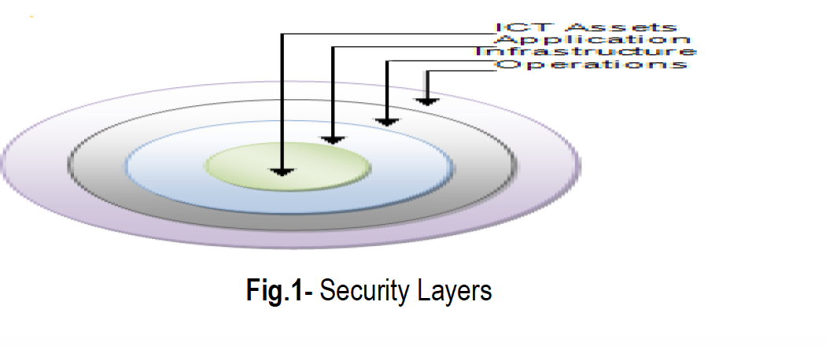
Security of What?
Security is all about protecting the Information and Communication Technology (ICT) assets of an organization.
The ICT assets themselves can be of a wide variety including the following:
Data, Information, Knowledge Resources, Programs, Hard-ware, Networks
Above mentioned some ICT assets which are very important for security perspective of E-governance.
This is a very important responsibility of E-governance administrators to protect these assets.

Slide 5
Security against What?
There are various threats to security of our ICT system, and we can’t define or declare them exactly, it may come from various sources and in various forms.
So it is very necessary for e-governance administrator to identify these threats.
we firstly give some sources of threats and then some types of threats which affect to E-governance.

Slide 6
Security against What?
Types of Threat:-
Threats may include unauthorized access, modification, and destruction of data.
The threats may be of different types varying from time to time because technology changes frequently.
The attacks on security of e-governance system can be in different forms including-
Defacing of web sites, Hacking, Cracking, Damage to critical database and applications, Network security check list, DSA, Viruses and Malwares etc.
the damage of ICT assets need not always be a result of such malicious attacks as mentioned previously.
It may be some kind of natural or environmental disasters etc

Slide 7
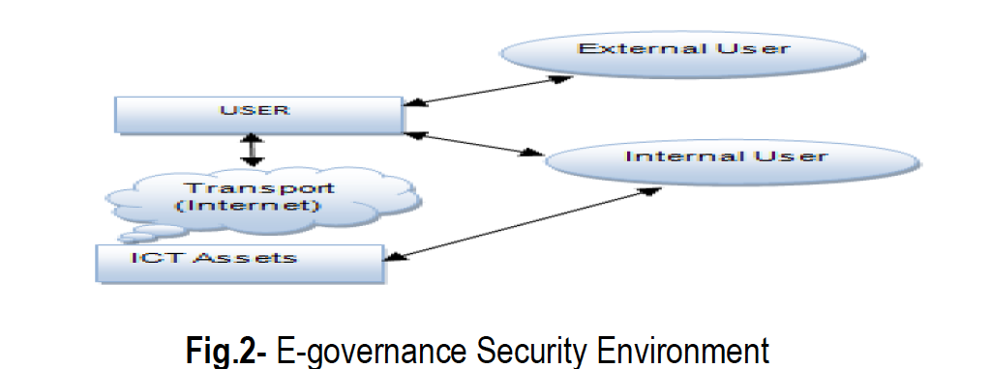
E-governance Security Model
The security of the e-governance system has to be managed systematically in three levels, this model is explained with the help of this figure

Slide 8
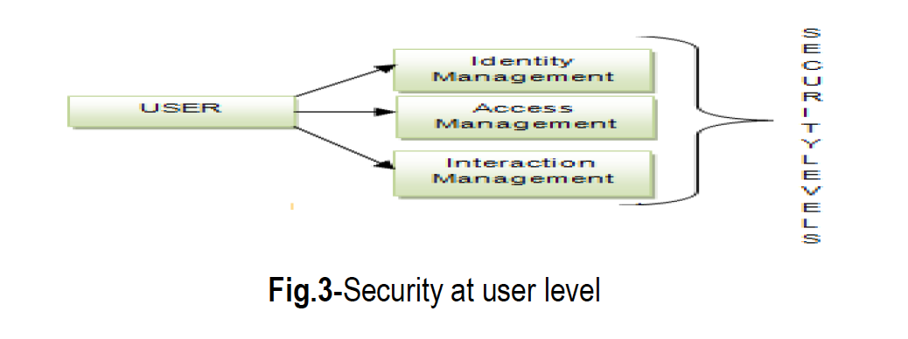
E-governance Security Model
Security at User Level :-
Security at user level is a very important issue. We can classify user level security management in three Part as shown in figure

Slide 9
E-governance Security Model
Security at User Level :-
Identity Management
The main purpose of this is to create unique digital identity or credential to all legal users by providing a unique user name and password, to create and manage ICT systems which ensure that the digital identities are secure.
Access Management System
In this level the unique credentials which are provided to the user at identity level are matched to identify the user, that he/she is actually the authentic person.

Slide 10
E-governance Security Model
Security at User Level :-
Interaction Management System
Interaction management is a most comprehensive and complex phase. It includes assurance of the Integrity, Confidentiality and Non-repudiation principles of a comprehensive security.
In user level, we can use various tools such as digital identity token, public key infrastructure (PKI), digital signature, asymmetric key cryptography etc. to provide or enhance the security at the user level.

Slide 11
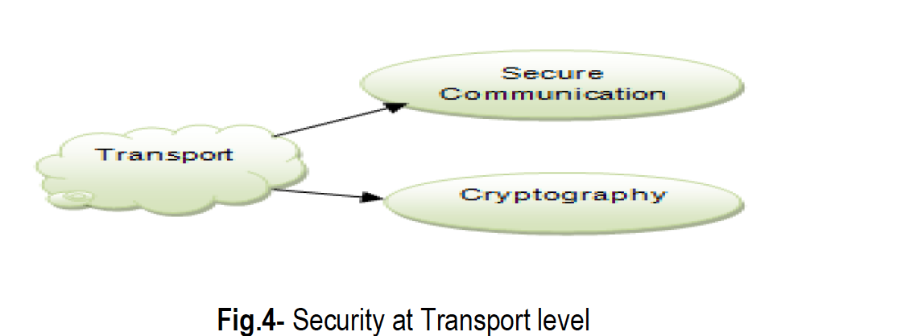
E-governance Security Model
Security at Transport Level :-
In this level we consider about e-governance security in two aspects which are security within LAN and WAN, and the second one is Security over the Internet.
This security level is classified into two systems,
Secure Communication System
Cryptographic System.

Slide 12
E-governance Security Model
Security at Transport Level :-
The data and information reaches through user to ICT assets or vice-versa, and when the data is in between these two i.e. in trans-missision medium which can be either LAN, WAN, or any wireless or any other medium whatever, then we need a higher security.
For this e-governance administrator use various tools or techniques like creating a Virtual Private Network (VPN), installing Firewalls, using higher and complex Encryption or decryption techniques etc.

Slide 13
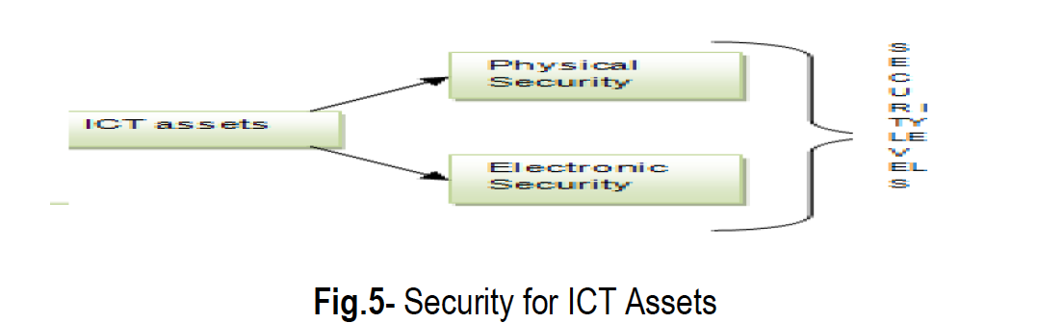
E-governance Security Model
Security at ICT asset Level :-
ICT assets are the most precious for any organization or institution, so to secure this level we have two broad categories of security treatment
Physical security
Electronic security.
.

Slide 14
E-governance Security Model
Security at ICT asset Level :-
Physical security:
It is used to protect the data against physical damages or losses like- natural disasters etc.
To protect data in this security level we take some steps such as- security level of data centers are highly secured by using biometric-controlled system,
In data centers provision of dust-proof environment, fire protection systems, security alarms, CCTV monitoring of data center etc. automated backup system.
By using some basic instructions we easily secure the data physically.

Slide 15
E-governance Security Model
Security at ICT asset Level :-
Electronic security:
To give the protection against digital threats we want to use electronic security.
We have various electronic security tools, and we can manage them in two categories
Anti-virus System
Firewalls
Fig 6: Categories of Electronic Security

Slide 16
E-governance Security Model
Security at ICT asset Level :-
Electronic security: Anti-virus System:-
When we discuss about digital threats the first thing in our mind is virus
Virus affects our ICT assets in various ways such as slowing down of the system, occupy disk space, corrupt our valuable data or storage medium etc.
it is also known as malware, worms and Trojan horses. there are “over 1,122,311 known viruses active in the world as of 2008
Thus proper antivirus system required to secure against viruses and malwares.
Fig 6: Categories of Electronic Security

Slide 17
E-governance Security Model
Security at ICT asset Level :-
Electronic security: Firewall System:-
A system designed to prevent
unauthorized access to or from a private network
A firewall is a security device that can be hardware or software that is mainly use for to separate a secure area from a less secure area and to control communications between the two.
We have several firewall techniques such as Packet filter, Application gateway, Circuit-level gateway, Proxy server.
There are many different brands of software firewalls, some of them are-
ZoneAlarm, BlackICE and Kerio etc.

Slide 18
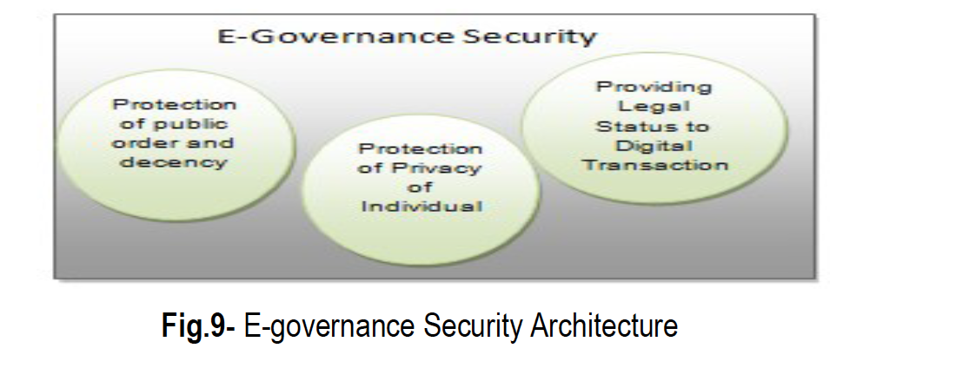
Security Architecture
The security architecture of E-governance is a high level document.
Sets the security goals of e-governance project and describe the procedure that need to be followed by all the e-governance hierar-chy such as users, businesses, operators etc.
Appropriate legal framework is absolutely essential for the systematic and sustained growth of e-governance.

Slide 19
Security Architecture
Protection of Public Order and Decency :-
The capacity of Internet along with multimedia is vague and impact is profound.
Government has to beware of its potential to create a negative impact on society through promotion of terrorism, pornography, communalism, violence etc
It a punishable offence to “publish or transmit or cause to be published it the electronic form, an material which is lascivious or appeals to the prurient interest or if its effect is such as to tend to deprave and corrupt persons who are likely, having regard to all relevant circumstances, to read, see or hear the matter contained or embodied in it
Goverment has to consider those and maintain protection of public order and decency.

Slide 20
Security Architecture
Protection of Privacy of Individuals :-
Disclosure of personal information over the internet raises questions related to the privacy of individuals.
The United States passes an Act which is “The Privacy Act of 1974”.
According to this Act any organization should followed some steps when it gathered any personal information of any individual- Notice, Choice, Onward Transfer and Security

Slide 21
Security Architecture
Providing Legal Status to Digital Identities and Transactions:-
One of the fundamental requirements of e-governance projects is its ability to create and sustain the operations of government agencies as well as private agencies.
So it’s very necessary to consult legal status of entities and actions such as-
legal status is to be provided to the digital identities
provide the legal recognition to digital assets
provide a digital authority to digital transactions, these transactions could be in the areas of G2G, G2B,G2C etc
Agreements and contracts in digital form
Electronic transaction Act need to be developed to address all of the above cases.

Slide 22
Information Security Policy / A frame work
Information security policy is a document which is prepared by an organization to addresses on the following terms-
“why, information security is important for an organization?”
“What are the possible security attacks?”
“What are the communication channels and ICT assets, which want to protect” etc.
also known as Information Security Management System (ISMS).

Slide 23
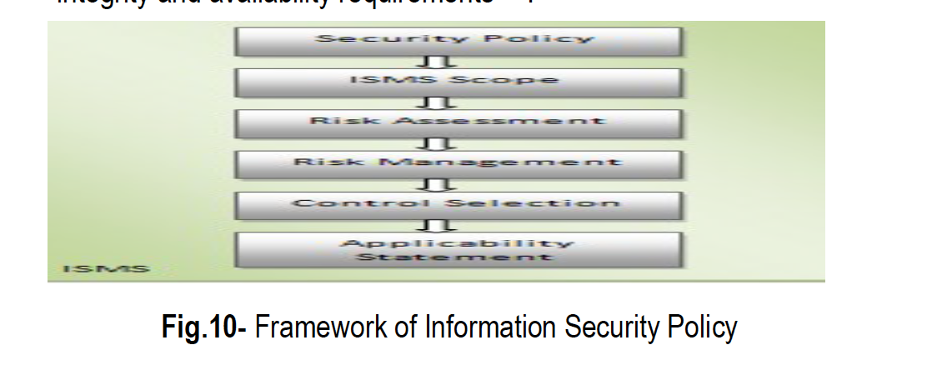
Information Security Policy / A frame work
ISMS is a set of policies which are concerned with security risk’s which are related to Information and Communication Technology.
“The establishment, maintenance and continuous update of an ISMS provide a strong indication that a company is using a systematic approach for the identification, assessment and management of information security risks.
Furthermore such a company will be capable of successfully addressing information confidentiality, integrity and availability requirements

Slide 24
Security Standards
The standard for information security was set by the BS 7799, being its popularity it was adopted by ISO as ISO 17799 and its sequel BS 7799-2 that prescribes the specification for Information Security Management.
The ISO 27001 standard was published in October 2005, essentially replacing the old BS 7799-2 standard.
It is the specification for an Information Security Management System.
ISO 17799 defines 127 security controls structured under 10 major headings to enable the information security manager to identify the particular safeguards that are appropriate to there specific area of responsibility

Slide 25
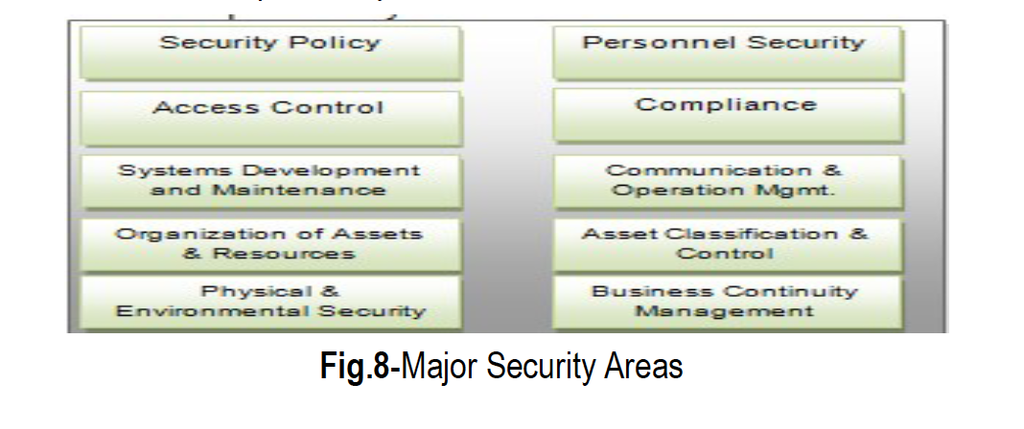
Security Standards
The major Security Areas are shown in the figure below

